Slide 1
cron and Scheduled Jobs
Cybersecurity
Lesson 5.2

Slide 2

Learning Objectives
By the end of today’s class, you will be able to:
Schedule regular jobs for individual users with crontab.
Write simple scripts for maintenance and security tasks.
Use cron to automate the execution of security scripts to perform maintenance.

Slide 4
Previously, we protected system stability by using tar to list and extract data, and to manually create backups that we can use to restore the system to an earlier state.

Slide 5

Scheduling Backups
Using cron to schedule regular automation of tasks
Scripts
Files that can contain multiple commands
Executed by calling name
Scheduled Jobs
Run commands or scripts at designated times

Slide 6

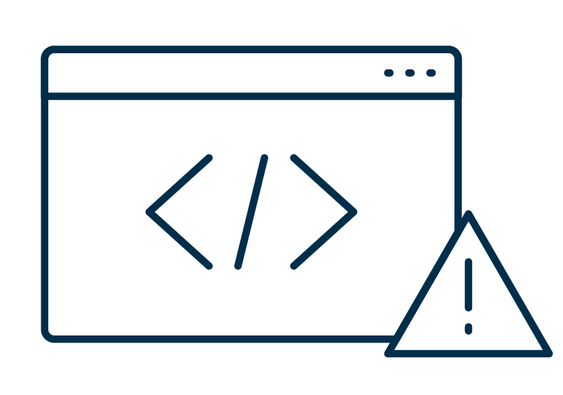

System Administration Workflow
Tools are often used together in a similar manner
Fix an Issue
Use cron to run the script
Write a script to solve issue automatically

Slide 7
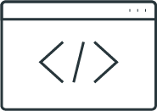
Overview of cron

Slide 8



Consider the Following Scenario
Before leaving work, you spend
10 minutes deleting your cache and your trash bin, and backing up your documents folder.
You also spend one hour per day installing software updates.

Slide 9
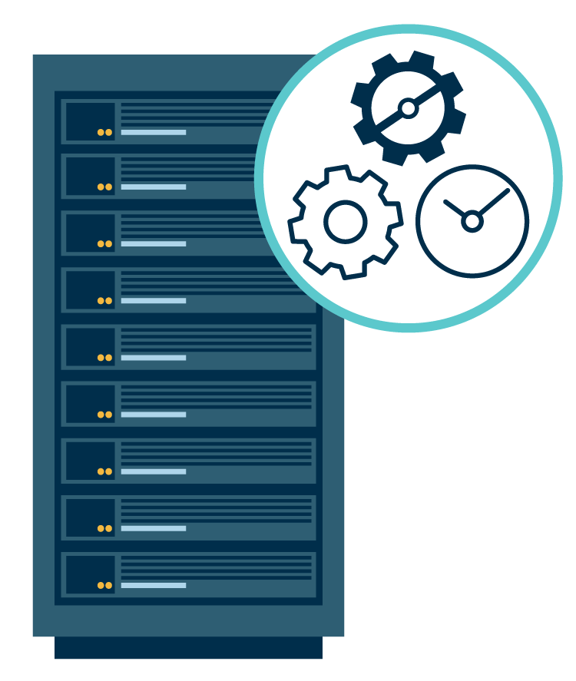
Introducing cron
Rather than spending time manually completing these repeatable tasks, you can automate them using cronjobs.

Slide 10
A cronjob is a script or command designated to run at regular or periodic, predetermined intervals.

Slide 11
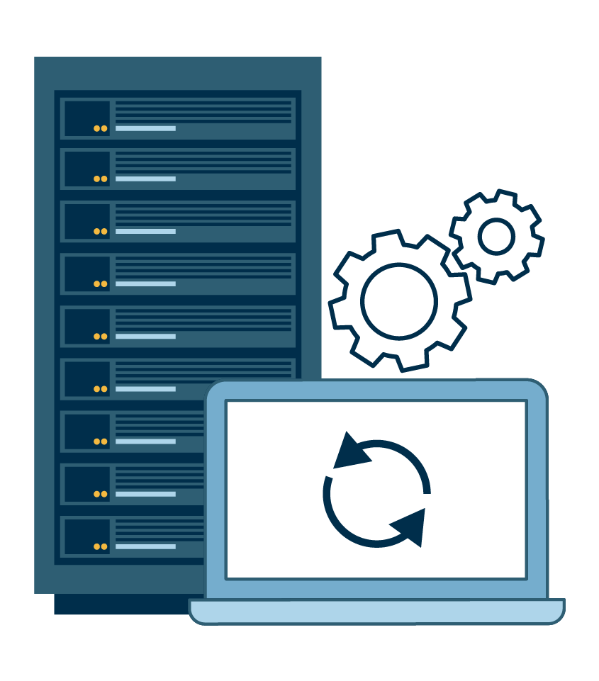
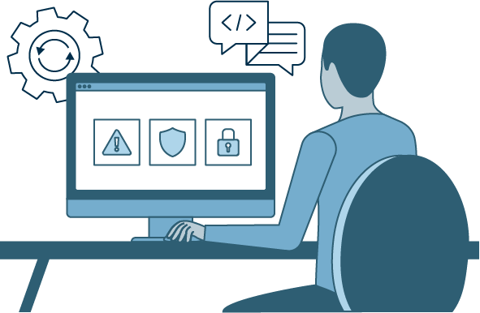
User-level
System-level
Automate the process of deleting cache, emptying trash, and backing up documents.
Automate daily software updates and installs.

Slide 12
The cron in cronjob refers to a system daemon that keeps track of when to run scheduled tasks.

Slide 13
A daemon is a computer program that runs as a background process, rather than being under the direct control of an interactive user.

Slide 14
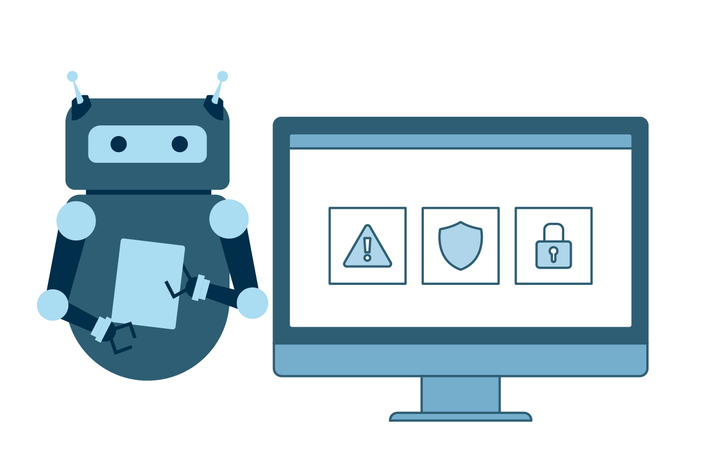
cron
cron is a robust task scheduler daemon that allows users to schedule repetitive tasks to run on a regular basis.
cron is most suitable for scheduling repetitive tasks.

Slide 15

Tasks are stored
and scheduled in
a file called a
crontab (cron table).
Each user has
their own individual, private crontab.
Tasks scheduled by users are run under that user’s privilege level.
System crontabs are for system
level actions.
Root users
can have a
crontab too.
Notes:
shutterstock_547734148

Slide 16

cron Syntax
Viewing and modifying the crontab
List the contents of crontab
crontab -l
Edit the crontab
crontab -e

Slide 17
cron Example
# Removes all files in the ~/Downloads directory at 11pm, every Saturday, every month
0 23 * * 6 rm ~/Downloads/*
0 | 23 | * | * | 6 | rm ~/Downloads/*
command to execute
day of the week (0-6)(Sunday = 0)
month (1-12)
day of month (1-31)
hour (0-23)
minute (0-59)

Slide 18

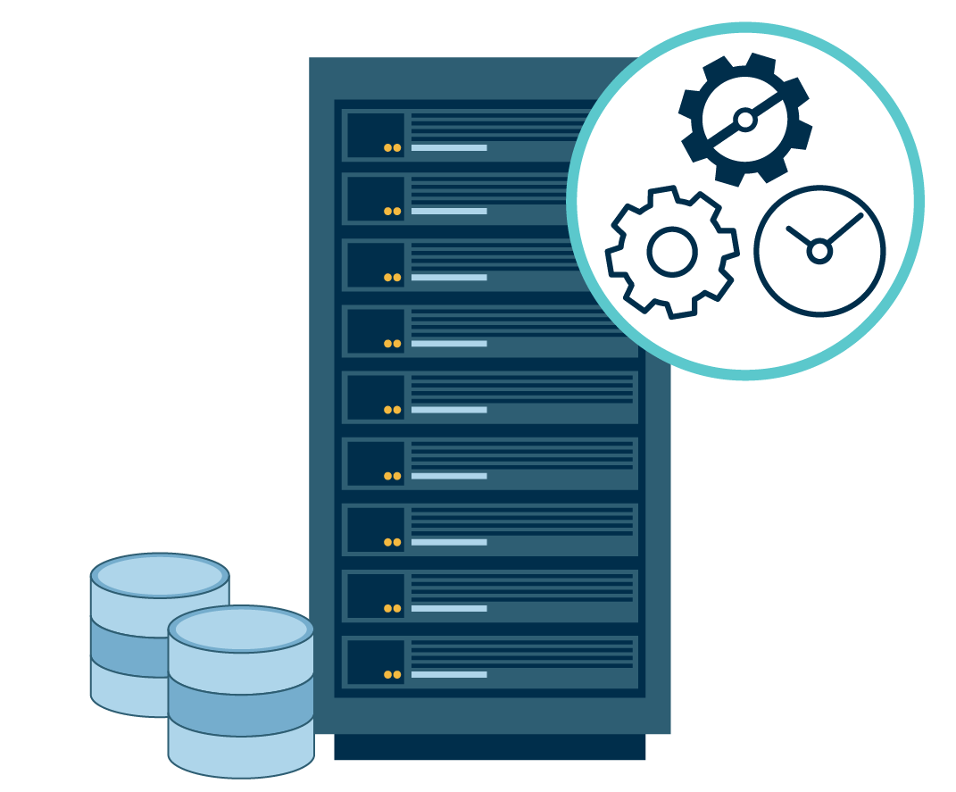
Demonstration Scenario
cronjobs run under the same permissions as the user who creates them. A cronjob created by user root will run with root privileges.
This introduces security risks. Anyone capable of privilege escalation can add a malicious cronjob to the root crontab.
We’ll revisit the risks of using cron with root privileges later in the unit.
Best practice is to avoid using the root crontab.
Notes:
shutterstock_1888488028

Slide 19
crontab Generator

Slide 20
Simple cronjobs
In this activity, you are a junior administrator at Rezifp Pharma Inc.
There has been a wave of recent ransomware attacks. You will be responsible for using cron to automate backup jobs for the E-Prescription Treatment database.
Rezifp Pharma Inc. maintains a large number of files associated with patients, doctors, and their treatments. Administrators at various clinics often create files that contain Personal Identifiable Information (PII) such as email addresses, passwords, biometric records, etc.
20 Minutes

Slide 23
Introduction to Scripts

Slide 24

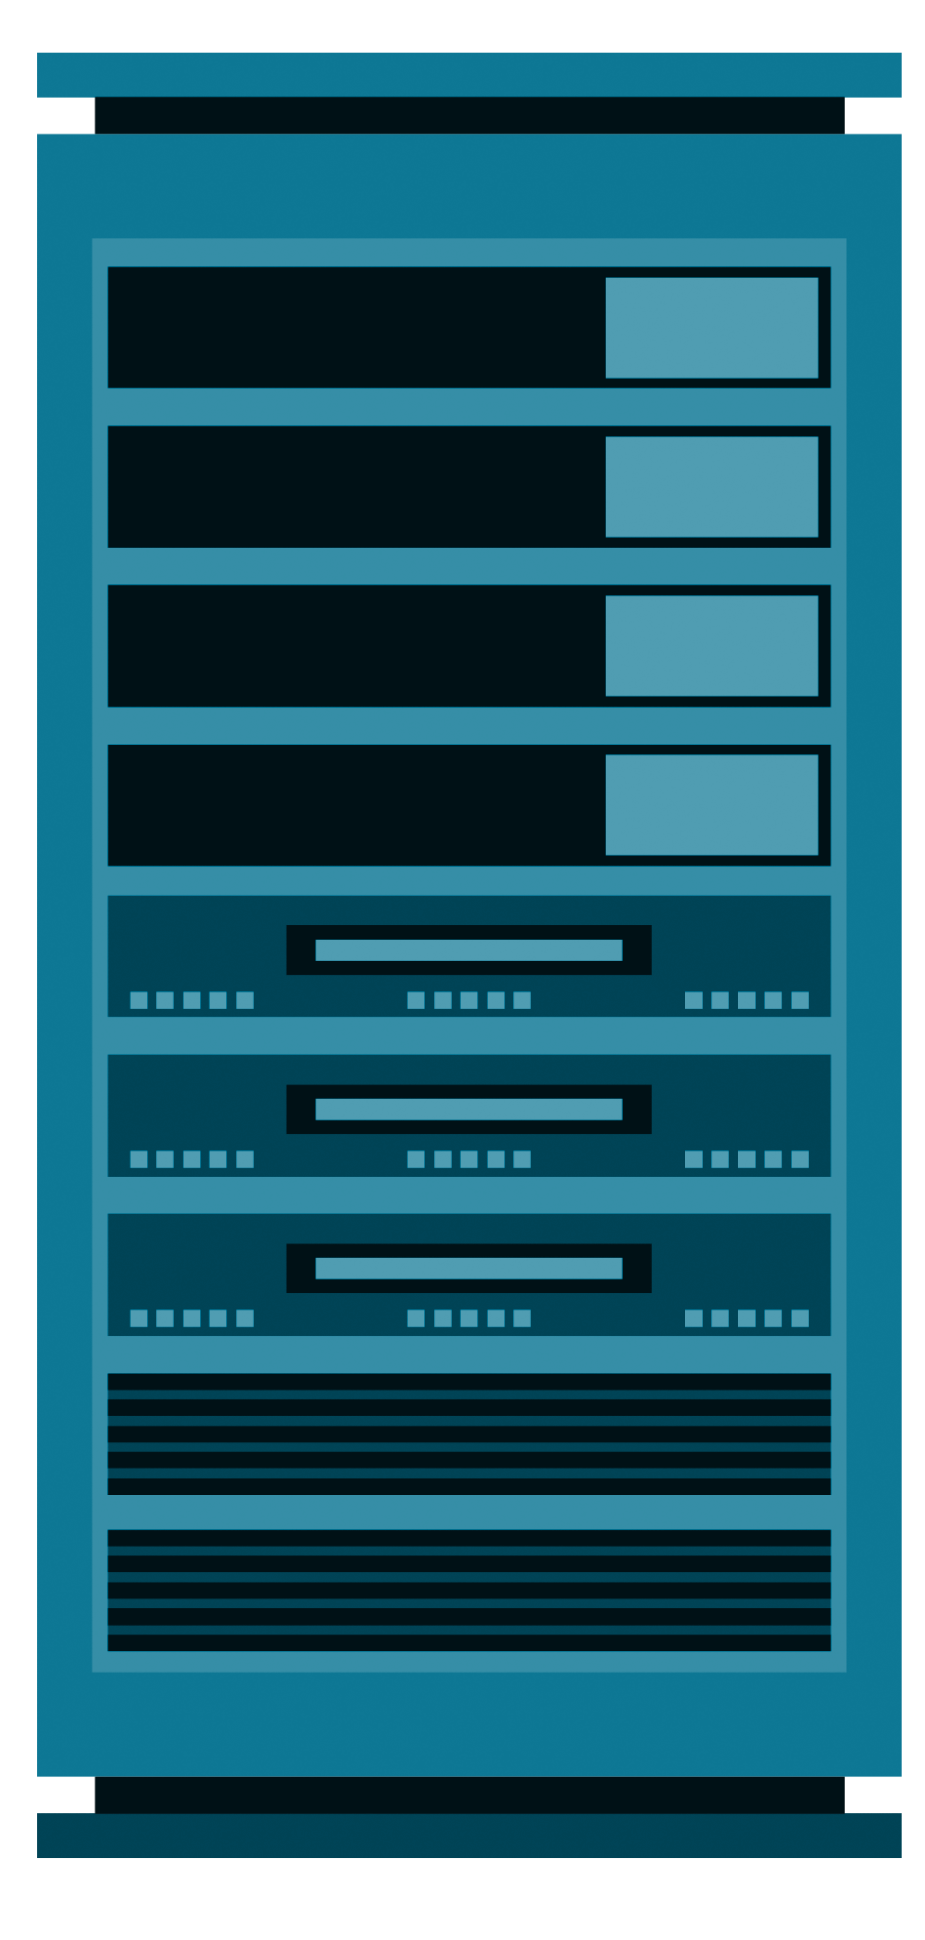
Why Scripts?
cron is useful for managing single function tasks
cron ideal for backing up a single directory:
/home
Not ideal for multiple directories:
/home/user1
/home/user2

Slide 25
Scripting

Slide 26


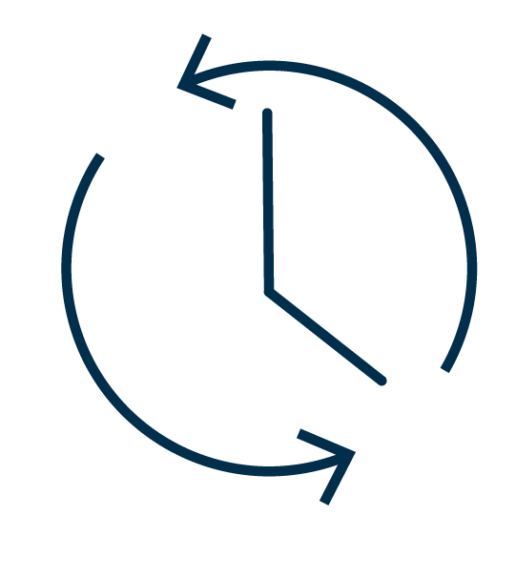
Demo Summary
In the previous demo, we did the following:
Updated crontab to run the script
Verified and executed our script
Saved commands into a custom script

Slide 27
Introduction to Scripts
In this activity, you'll continue to play the role of a junior administrator at Rezifp Pharma Inc.
In response to malware, adware, and virus attacks, your organization has asked you to ensure proper configuration management of all networking equipment and associated systems.
Previously, you learned how to schedule backups using cron. Your senior systems administrator has requested that you begin automating these tasks by writing scripts.
30 Minutes

Slide 31
Scheduling Backups, Cleanups,
and Security Checks

Slide 32
crontabs belong to individual users and are designed to be run with the same permissions.
Therefore, they are typically unable to modify the system due to lack of root privileges.

Slide 33



System-Wide cron Directories
-System-wide cron directories:
/etc/cron.d
/etc/cron.daily
/etc/cron.weekly
/etc/cron.monthly
-cronjobs that run with root privileges
-Dedicated time intervals:
/etc/cron.weekly runs once per week

Slide 34
Now we’ll examine the /etc/cron directories.

Slide 35
cron Directories

Slide 36

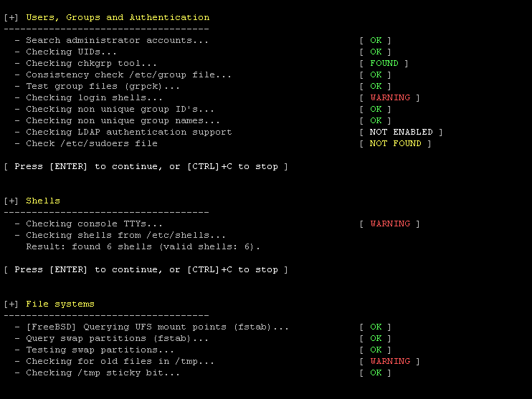
Lynis Scanner
Security scanner used to scan for vulnerabilities
Generates and saves reports
Numerous scan type options

Slide 37
Lynis

Slide 38
Scheduling Backups, Cleanups, and Security Checks
In this activity, you'll continue to play the role of a junior administrator at Rezifp Pharma Inc.
Now that you've developed scripts to keep the system clean, up-to-date, and properly backed up, the senior security manager has requested that you begin using system-wide cron directories to schedule your scripts. Additionally, you have been asked to schedule regular security scans with Lynis.
20 Minutes

Slide 41

Recap
cron and Scheduled Jobs
01
Scheduled regular jobs for individual users with crontab.
02
Write simple scripts for maintenance and security tasks.
03
Use cron to automate the execution of security scripts to perform maintenance on a regular basis.

Slide 42
bash Scripting

